Slide 1

Helping Your Child with Attention, Organization and School after Transplant
Celebrating a Second Chance at Life Survivorship Symposium
April 30 - May 6, 2022
Beth Colaluca PhD
Cook Children's Medical Center

Slide 2


Helping Your Child with Attention, Organization & Learning Challenges after Transplant
Presented by Beth Colaluca, Ph.D.
Pediatric Neuropsychologist
Department of Neurosciences
Cook Children’s Medical Center

Slide 3
Objectives:
Identify risks for neurocognitive challenges following transplant
Describe methods of assessment for determining a child’s cognitive strengths and limitations
Demonstrate knowledge of available school-based services including 504 plan and Individualized Education Plan (IEP)
Identify methods to request and/or advocate for school-based interventions across a child’s educational career
Explain strategies for use at home and in school to support children with neurocognitive challenges

Slide 4
Risks for Cognitive Challenges
Age at time of treatment – younger age higher risk
Previous treatment
Treatment type – chemotherapy vs radiation
Treatment intensity
Diagnosis – central nervous system involvement
Length since time of treatment
  Growing into deficits – demands increase
Gender – females more vulnerable?
Baseline level of functioning

Slide 5
Cognitive Challenges that increase Risks for Academic Difficulties
Inattention – loss of focus leads to less encoding & storage of new information
Executive functioning – demands for organization, planning increase with age
Slow processing speed – inability to “keep up”

Slide 6
Assessment Methods
Neuropsychology – study of brain/behavior relationships
Functional evaluation of the brain
Standardized testing of different cognitive domains across the lifespan
Identify individual strengths & weaknesses in at-risk populations
Parent interview, review of records, behavioral observations & testing

Slide 7
Neuropsychological vs Psychoeducational testing
School-based testing conducted to determine IF there is a problem – IQ & achievement
  Conducted every 3 years
Neuropsychological testing identifies:
  Cognitive processes underlying problem
  Strengths that can be capitalized upon
Useful to assist with intervention planning

Slide 8
Neuropsychological Domains
Intelligence & Academic Functioning
Attention
Executive Functioning
Learning and Memory
Visuospatial Functioning
Language
Sensorimotor Functioning
Emotional/Social/Behavioral functioning
Adaptive Behavior

Slide 9
Intelligence
IQ tests include measures of:
  Nonverbal/perceptual reasoning
  Verbal abilities
  Working memory
  Processing speed

Slide 10

Academic Functioning
Word recognition
Reading comprehension
Reading fluency
Math computation
Math problem solving
Math fluency
Spelling
Expressive writing
Writing fluency

Slide 11
Attention
  Focused – basic response to stimuli
  Divided – multi-tasking
  Selective – filtering out non-essential info
  Sustained – maintaining focus over time
  Alternating – changing tasks quickly

Slide 12
Executive Functioning
Higher level cognitive skills that control behavior & emotion
Goal setting
Inhibition
Cognitive flexibility
Planning
Initiation
Organization
Working memory

Slide 13

Executive Functioning Tests

Slide 14
Executive Functioning Tests
Planning & reasoning
G
R
G
B
G
B
G
R
B
B
R
R
Initial Position
Goal Position #2
Goal Position #6
Goal Position #10

Slide 15
Learning & Memory
Verbal memory
  Contextual memory
  Rote learning
Visual memory
  Spatial learning
  Contextual memory
  Facial recognition

Slide 16
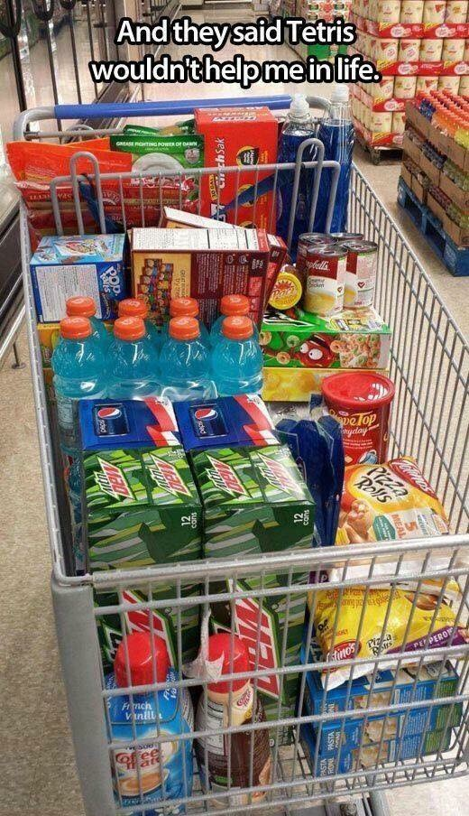
Visuospatial Processing

Slide 17
Verbal/language
Naming
Word finding
Conversational fluency, rate/rhythm, prosody
Phonological processing
Comprehension
Receptive language

Slide 18
Sensorimotor Functioning
Finger-tapping
Finger sequencing
Pegboard tests
Grip strength
Sensory-perceptual tests
Visual-motor integration

Slide 19
Emotional/Social/Behavioral Functioning
Changes may result from direct or indirect effect of medical condition
Emotional adjustment disorders associated with medical condition
May impact performance on testing and in school (e.g. anxiety could result in poor performance on measures of attention)

Slide 20
Adaptive Behavior
Ability to take care of ourselves, interact with & help others at an age-appropriate level
Adaptive functioning deficits even with average IQ
  Social skills problems
  Safety skills
  Employability

Slide 21
Making Sense of the Data
History, behavioral observations, records review & test data combined to formulate hypotheses
Validity concerns – cultural/language differences, sensory impairment, effort, motivation, anxiety
No single test used to make a diagnosis

Slide 22
Neuropsychological testing for transplant
Pre-transplant baseline evaluation – may be complicated by medical factors and/or anxiety
1 year post transplant and as needed following transplant for up to 7 years
Any medical condition/treatment that can impact brain functioning

Slide 23
Advocating for services in school
Start with student’s teacher to identify concerns
Response to Intervention (RTI) coordinator – documentation of disability
Section 504 coordinator
Request Admission, Review, Dismissal (ARD) meeting
  Request in writing to school
  School district has to complete evaluation within given time frame
Advocate through school district

Slide 24
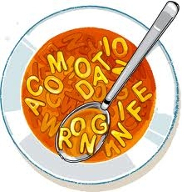
Navigating the school system
Alphabet soup – what do all the acronyms mean??
ARD – Admissions, Review, Dismissal
IEP – Individualized Education Plan
FIE – Full & Individual Evaluation
IHP – Individual Health Plan

Slide 25
School-based services
504 – accommodations to educational setting; not change in curriculum
Individualized Education Plan (IEP) – curriculum modified to meet student’s needs
Response to Intervention (RTI)
Homebound services

Slide 26
Individualized Education Plan (IEP)
  IEP – modifying curriculum; shortened assignments; individualized support
  IEP review annually – re-evaluation every 3 years
    School does NOT have to accept outside evaluations
  Measurable goals
  Description of instructional placement – inclusion vs resource room
  ARD transition meetings

Slide 27
Special Education categories
Other Health Impairment (OHI)
Autism
Hearing impairment
Visual impairment
Emotional disturbance
Intellectual disability
Specific learning disability
Speech/language impairment
Traumatic brain injury
Orthopedic impairment

Slide 28
504 Accommodations
“Physical or mental impairment that substantially limits one or more life activities”
Accommodations to educational setting; not change in curriculum
Covers medical conditions
Attention Deficit Hyperactivity Disorder (ADHD)
Fewer legal rights under 504 vs IEP

Slide 29
Accommodation strategies – Attention
Frequent, short breaks
Preferential seating
Distraction free seating for testing
Extra time (also for slow processing speed)
Note taker/copies of notes & homework instructions
Fidgets

Slide 30
Accommodation strategies - Memory
Shortened instructions with repetition as needed
Multisensory presentation of information
Visual aids - manipulatives
Break projects down into smaller steps
Organizational tools – calendars, planners, deadlines

Slide 31
Accommodation strategies – Executive Functioning
Break down overwhelming tasks into smaller steps
Goal setting
Deadlines
Organizational tools – planners

Slide 32
Accommodation strategies - Comprehension
Simplify directions
Provide demonstration of tasks
Ask student to demonstrate understanding of instructions
Tutoring
Individualized instruction

Slide 33
Additional academic supports
Speech/language therapy
Occupational therapy – fine motor control affecting handwriting
Physical therapy
Counseling/social skills training
Extended year services (EYS)
Behavioral intervention plans (BIP)
Assistive Technology – smart pen

Slide 34
Other support strategies
Structured schedule
Visual reminder cues
Academic coaching – teaching how to manage academic skills
Medication for attention problems

Slide 35
Executive Functioning Resources
Smart but Scattered – Peg Dawson, EdD & Richard Guare, PhD
Smart but Scattered Teens – Richard Guare, PhD, Peg Dawson, EdD & Colin Guare
Late, Lost and Unprepared – Joyce Cooper-Kahn, PhD & Laurie Dietzel, PhD

Slide 36
Resources
http://www.wrightslaw.com
WWC | Find What Works! (ed.gov) –
  https://ies.ed.gov/ncee/wwcWhat works clearinghouse
http://www.pacer.org/
http://sat.collegeboard.com/register/for-students-with-disabilities
http://www.NavigateLifeTexas.org
http://www.disabilityrightstx.org/

Slide 37
Conclusions
Neuropsychological testing useful at detecting changes post transplant
Provides documentation needed to receive services
IEP – falling behind curriculum
504 – accommodations to increase likelihood of success with grade appropriate curriculum

Slide 38

Questions?
Beth Colaluca PhD
Celebrating a Second Chance at Life Survivorship Symposium 2022
bmtinfonet.org ✦ help@bmtinfonet.org ✦ 847-433-3313

Slide 39
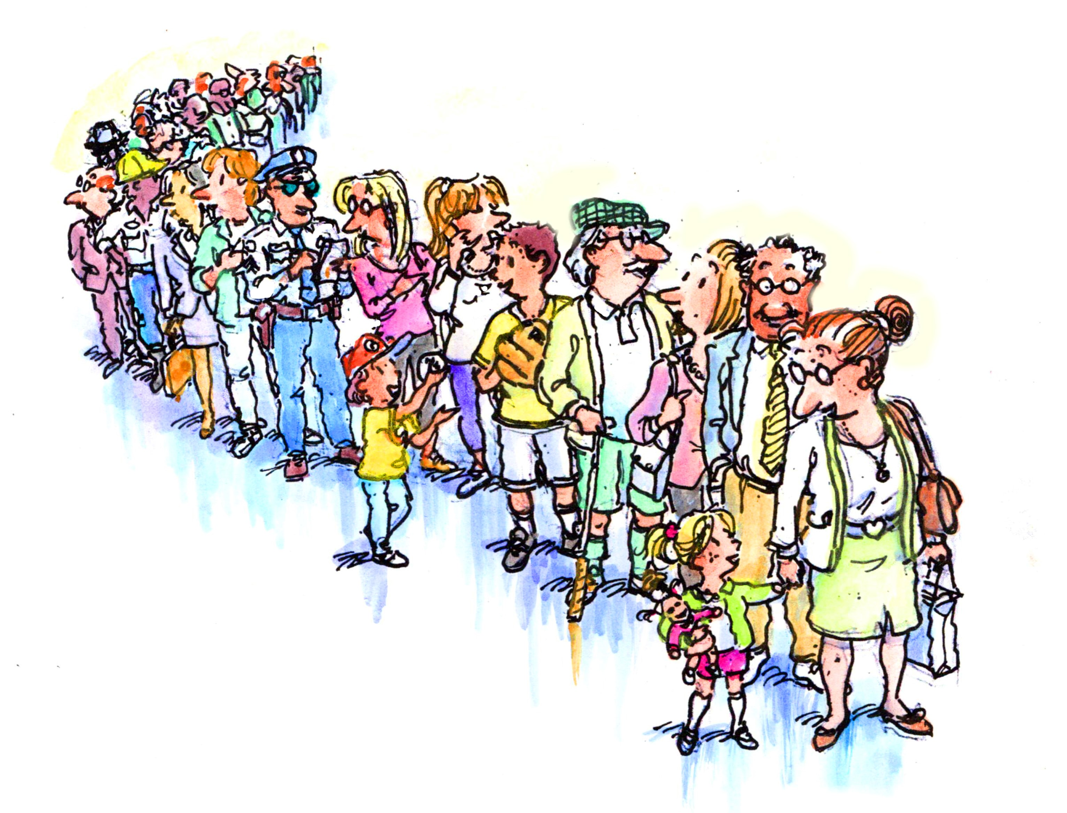
Let Us Know How BMT InfoNet Can Help YOU!
Visit our website: bmtinfonet.org
Email us: help@bmtinfonet.org
Give us call: 888-597-7674
We're here to help every step of the way!

