Slide 1
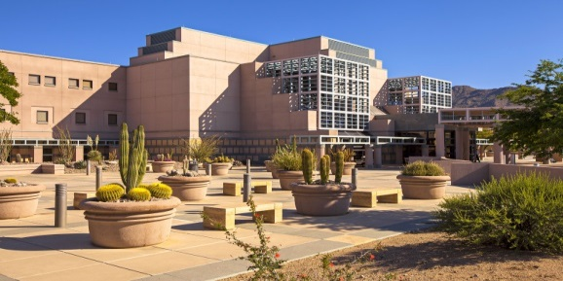
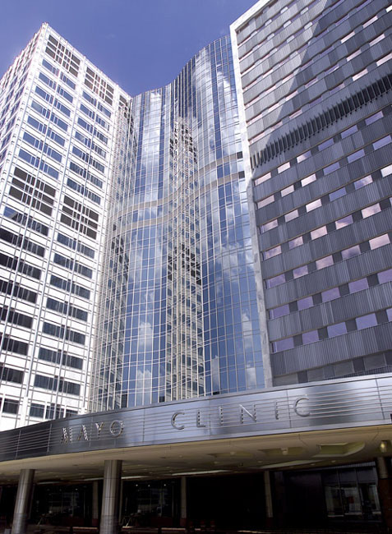
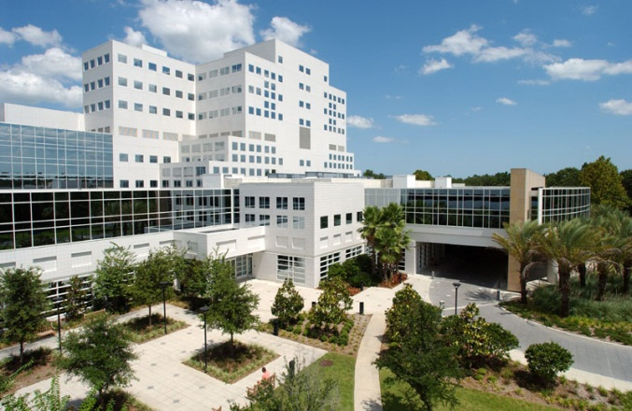
Acute Myeloid Leukemia:
Increasing Complexity and
Increasing Treatment Opportunities
Mark R. Litzow, MD
Professor of Medicine
Mayo Clinic College of Medicine
Mayo Clinic Comprehensive Cancer Center
October 14, 2021
Scottsdale, Arizona
Rochester, Minnesota
Jacksonville, Florida

Slide 2
Learning Objectives
Review the current classification and clinical manifestations of acute myeloid leukemia (AML)
Outline the classification of AML into different subtypes
Discuss the new options for treatment of AML
Review new approaches to the use of blood and marrow transplantation (BMT)

Slide 3
Definition of Leukemia
Clonal (means arising from one cell) stem cell malignancy with excessive production of immature or mature white blood cells that accumulate in the bone marrow, peripheral blood and/or other tissues.
Acute = immature cells (blasts), high proliferative rate
Chronic = mature cells, lower proliferative rate
Broadly classified into myeloid and lymphoid types
©2011 MFMER

Slide 4
Hematologic Malignancy
Myeloid Cancer
Lymphoid Cancer
Chronic Myeloid
Disorders
Acute Myeloid
Leukemia
Chronic Lymphoid
Disorders
Acute lymphoid
leukemia
Myelodysplastic
Syndromes
Chronic lymphoid
leukemia
Myeloproliferative
Disorders
Plasma Cell
Disorders
Lymphoma
Hodgkin
NHL
©2011 MFMER

Slide 5
Acute Myeloid Leukemia (AML)
~90% of all acute leukemia cases are AML
Median age at diagnosis is 68 years
5-year overall survival:
< 5% in patients > 65 years old
< 50% in patients < 45 years old
~ 60% in children
©2011 MFMER
Notes:
Akylators - 5-10 years
Topoisomerase II inhibitors - 1-5 years

Slide 6
Symptoms of AML
Low blood counts that cause bleeding, fatigue, infection
Enlarged liver and spleen
Blast crisis: high number of immature cells (blasts) in the bloodstream
Granulocytic sarcoma - leukemic cells in soft tissues such as bone, skin or lymph nodes, breast, etc.
Tumor lysis syndrome
Blood clotting abnormalities
©2011 MFMER

Slide 7
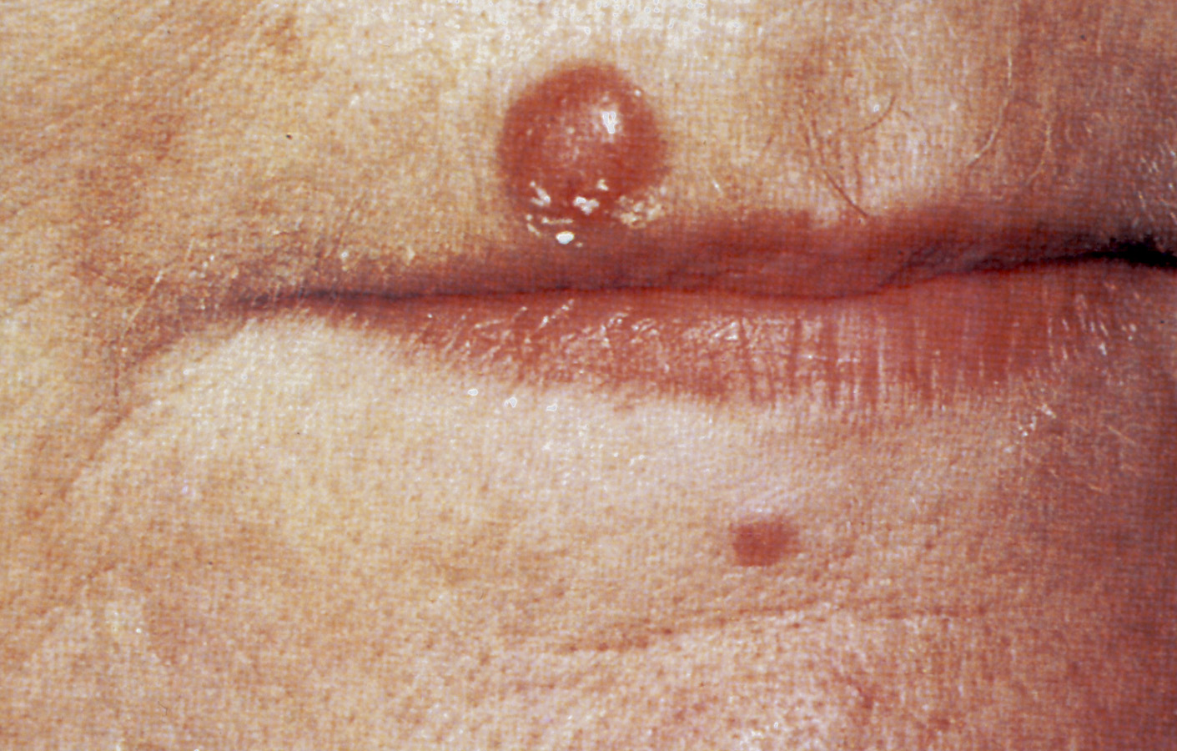

Slide 8
Very High White Blood Cell Count Blast Crisis
Blast count in blood at or approaching 100x10⁹/L
Changes in vision
Central Nervous System – altered mentation, bleeding
Focal neurological deficits- arm or leg weakness, slurred speech
Respiratory distress – shortness of breath
Excessive clotting of blood
Treatment: urgent leukapheresis, hydration, medications: hydroxyurea, allopurinol
©2011 MFMER

Slide 9
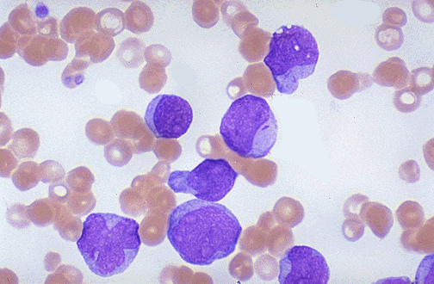
What AML Looks Like Under the Microscope
Auer rods-
A line of crystallized granules, typical in patients with AML
©2011 MFMER
Notes:
Auer rods

Slide 10
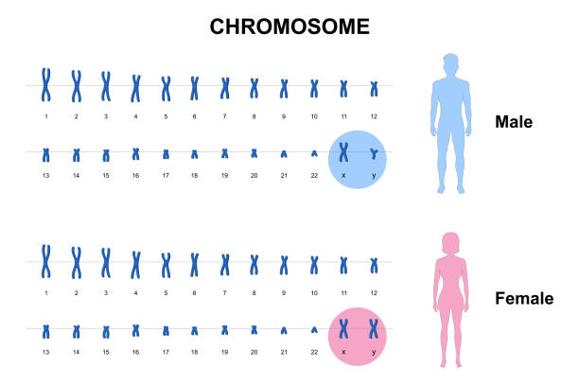
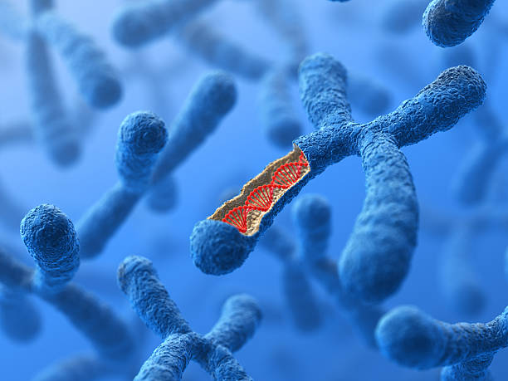
Chromosomes (Cytogenetics)

Slide 11
AML: Chromosome and Gene Abnormalities
Letters in red refer to specific genes that get mutated
ASH-SAP 2016; AML

Slide 12
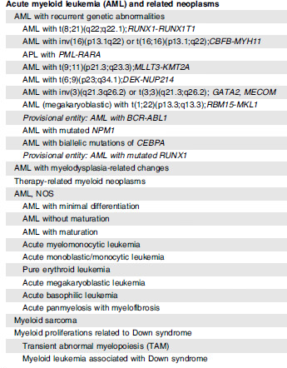
World Health Organization Classification of AML 2016
Blood,2016; 127(20), 2391-2405

Slide 13
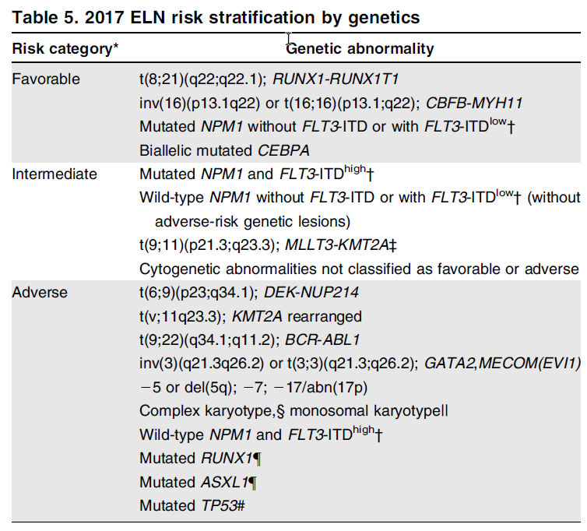
AML Risk Categories
Developed by a group of doctors - the European Leukemia Net (ELN)
Poor prognostic factors:
Older age (>40)
Extramedullary disease
Prior hematologic disorder e.g. (myelodysplastic syndrome, myeloproliferative neoplasm)
White blood count > 50,000
Genetic prognostic factors
©2011 MFMER

Slide 14
Initial Treatment for AML
Two phases of initial therapy:
Induction: to reduce leukemic burden and achieve remission
Consolidation: to eliminate residual leukemic cells, maintain remission
Traditionally standard induction using an anthracycline (daunorubicin/idarubicin) daily for 3 days + cytarabine by continuous infusion for 7 days (referred to as 3+7 or 7+3)
©2011 MFMER

Slide 15
Side Effects of Drugs Used to Treat AML
Cytarabine
Neurologic side effects such as loss of balance
Conjunctivitis (irritation of the white of the eye and preventable with corticosteroid eye drops)
Anthracyclines (daunorubicin/idarubicin)
Damage to the pumping function of the heart

Slide 16
Allogeneic Transplant for Patients in First Remission
Allogeneic transplant is a stem cell transplant using donor cells
Powerful antileukemic treatment, but associated with significant side effects: graft-versus-host disease, infection and internal organ damage
Usually not done in favorable risk patients if they achieve a good remission
Considered for all other patients (intermediate and high risk) because of concern of higher risk of relapse in these patients with chemotherapy

Slide 17
Treatment for Relapsed AML
Strive for second remission
If 1st remission is < 6 months, unlikely to respond to standard chemotherapy
If 1st remission is > 12 months, 50% will respond to high dose cytarabine or repeat 7+3
Strongly consider enrolling in a clinical trial if available
Follow with allogeneic stem cell transplant as relapse will occur again without transplant

Slide 18
New Drugs for AML in 2017
The first new drugs for AML in 40 years!
Midostaurin (Rydapt®) for newly-diagnosed FLT3_{mut} AML
CPX-351 (Vyxeos®) for therapy-related AML, or with MDS-related changes
Gemtuzumab ozogamicin (Mylotarg®) for CD33+ AML adults, relapsed adults and children - reapproved from 2000
Enasidenib (Idhfa®) for IDH2_{mut} relapsed/refractory AML

Slide 19
More New Drugs for AML 2018-2020
Ivosidenib (Tibsovo®) for IDH1_{mut} relapsed/refractory AML
Glasdegib (Daursmo®) and Venetoclax (Venclexta®) for newly diagnosed patients ≥75 years old, or unfit patients.
Gilteritinib ( Xospata®) for FLT3_{mut} relapsed/refractory AML
Tagraxofusp-erzs (Elzonris®,SL-401) for blastic plasmacytoid dendritic cell neoplasm (BPDCN)
Oral Azacitidine (Onureg®) for AML maintenance therapy

Slide 20
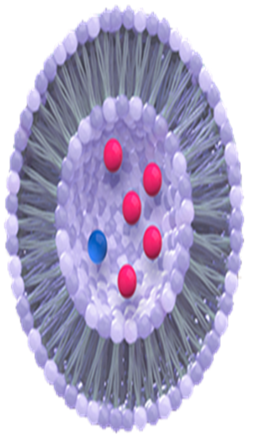
CPX-351 (Vyxeos®) Uses a Nano-Scale Delivery Complex
Nano-technology (Nano = one billionth of a meter)
Chemotherapy drugs surrounded by a lipid (fat) capsule
Longer availability of drug in the body
Selectively targets AML cells
5 cytarabine molecules to one daunorubicin molecule
Fewer side effects

Slide 21
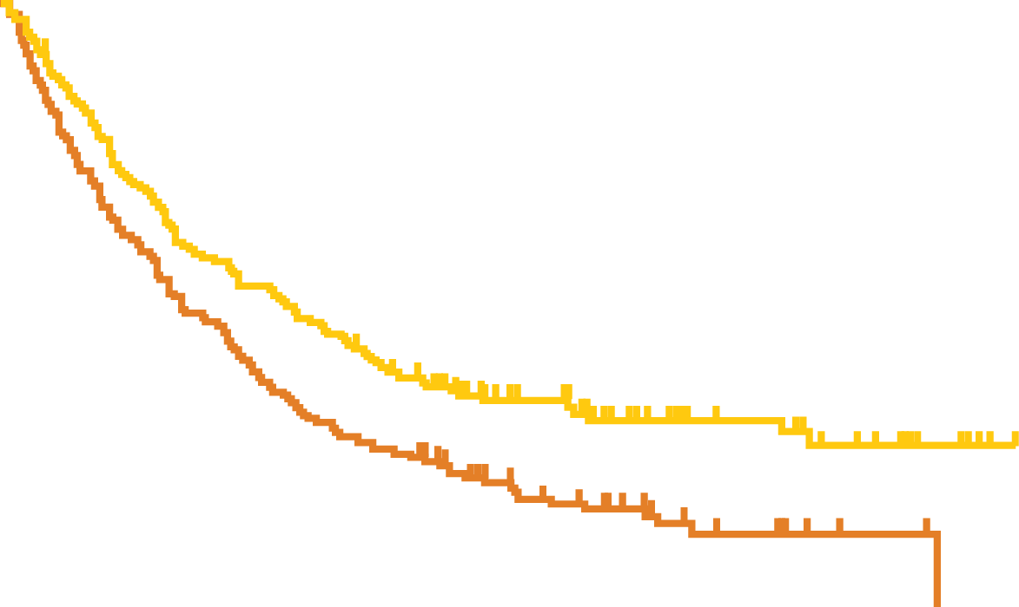
CPX-351 (Vyxeos®) in Poor Risk AML
100
Events/N
80
CPX-351
7+3
104/153
132/156
60
Survival (%)
40
20
0
0
3
6
9
12
15
18
21
24
27
30
33
36
Months from Randomization
Notes:
Data source: “CPX-351 Phase III results…” PDF: Curve = p. 24, Hazard Ratio = p. 7, 2-sided p-value = p. 1
Percentage of patients alive:
at 12 months: 41.5% of CPX-351 patients, 27.6% of 7+3 patients
at 24 months: 31.1% of CPX-351 patients, 12.3% of 7+3 patients

Slide 22
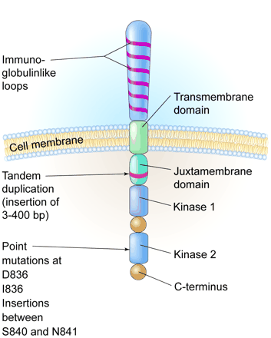
FLT3
A schematic diagram of the FLT3 receptor tyrosine kinase showing the location of the internal tandem duplication of genes within the juxtamembrane domain and point mutations and gene insertions in the second kinase domain. Illustration by Kenneth Probst. From Litzow, MR. Blood 106:3331, 2005.

Slide 23
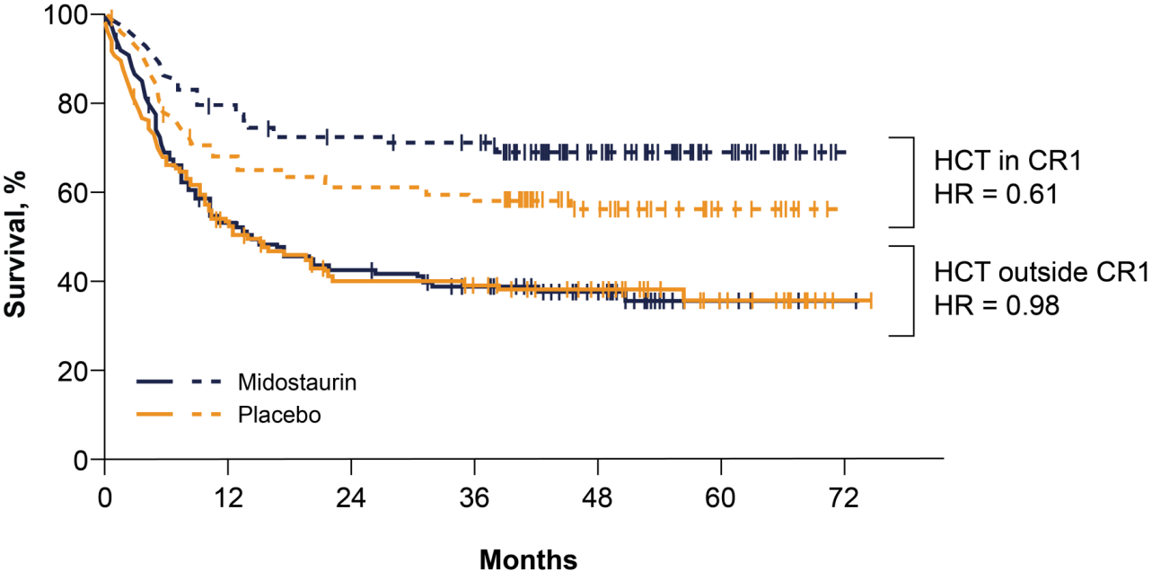
FLT3 Mutation ~30% AML RATIFY Study - Overall Survival
All Patients
Transplanted Patients
4-Year Survival:
Midostaurin
51.4%
Placebo
44.3%
Notes:
CR by day 60 mido 59% placebo 53%
CR at any time mido 66%, placebo 59%
Median time to CR was 37 days with mido vs. 36 with placebo
OS improved with midostaurin
74.7 vs 25.6 months (P = .009)
Transplantation during first CR
28.1% in the midostaurin group vs 22.7% in the placebo group
Overall HCT
58% in the midostaurin group vs 54% in the placebo group
4-y OS among HCT patients
63.7% in the midostaurin group vs 55.7% in the placebo group (P = .08 by log-rank test)

Slide 24
Gilteritinib (Xospata®) for AML with FLT3 mutation
Gilteritinib (Xospata®) compared to chemotherapy:
Median* overall survival with gilteritinib was 9 months, versus 6 months with chemotherapy
37% were alive at 1 year, versus 17% with chemotherapy
19% were alive at 2 years, versus 14% with chemotherapy
ADMIRAL Trial Phase 3
*Median is the point at which half the cases occur before, and half after. It is different than the average.

Slide 25
Giltertinib (Xospata®) vs Midostaurin (Rydapt®)
An Ongoing Clinical Trial - PrE0905 - will study which drug, when combined with chemotherapy, is best to treat patients with FLT3-mutated AML
Perl A, et al. NEJM 381:1728, 2019

Slide 26
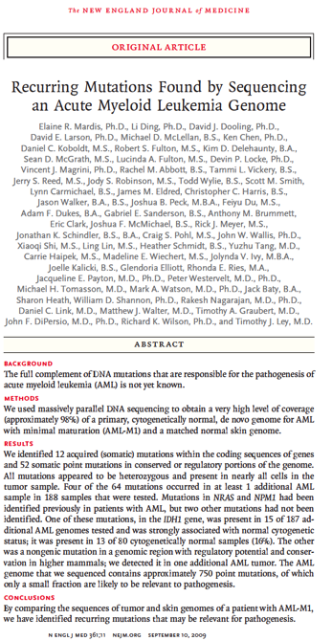
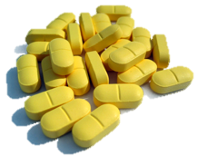
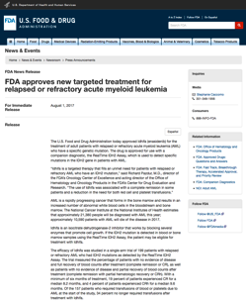
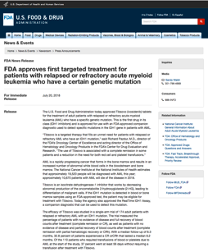
Isocitrate Dehydrogenase (IDH) Mutations
as a Target in AML
First patient treated
Sept 2013
Sept 10, 2009
Mar 16, 2010
Aug 1, 2017
July 20, 2018
APPROVED
APPROVED
Enasidenib IDH2
Ivosidenib IDH1
Notes:
remove line

Slide 27
Age-Specific AML Incidence Rates
Approx. 39% over age 65 yrs receive Intensive Chemo - ‘Fit’ patients
Juliusson, Blood 2009. Borlenghi, Blood 2014
Notes:
AML is generally a disease of older people. The median age of individuals with newly diagnosed AML averages 66 to 68 years. Incidence increases with age, peaking in the 80- to 84-year-old group. Data are from the Swedish Acute Leukemia Registry, which contained 2,866 cases of AML diagnosed from January 1997 through September 2005. The median age was 72 years (quartile values 60-79 years, range 16-97 years, mean 68 years); 71 years for males and 72 years for females.

Slide 28
Who is Fit for Intensive AML Therapy?
Age
Performance Status
Comorbidity (other health issues)
Studies being done to more formally and objectively define “fitness”
Sometimes leukemia-related factors suggest more appropriate treatment with low intensity therapy (e.g. decitabine for TP53_{mut})
Ferrara F. et al, Leukemia 27:997, 2013

Slide 29
Venetoclax (Venclexta®) - BCL2 specific inhibitor
FDA approved for CLL, SLL, AML.
Active in myeloma, mantle cell lymphoma, other Nnon-Hodgkin lymphoma, Waldenström macroglobulinemia

Slide 30
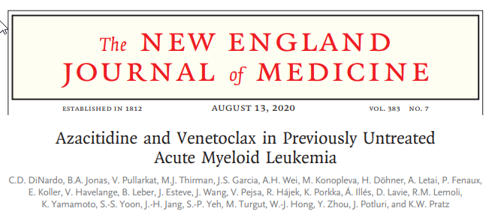
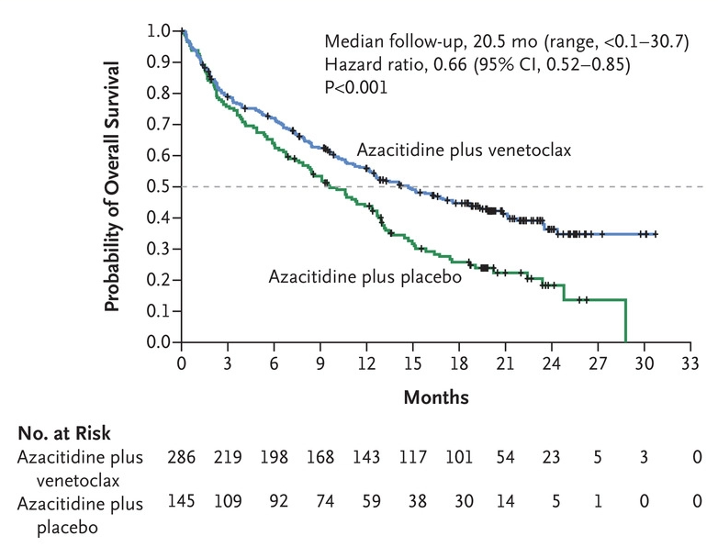
(n=286)
(n=145)

Slide 31
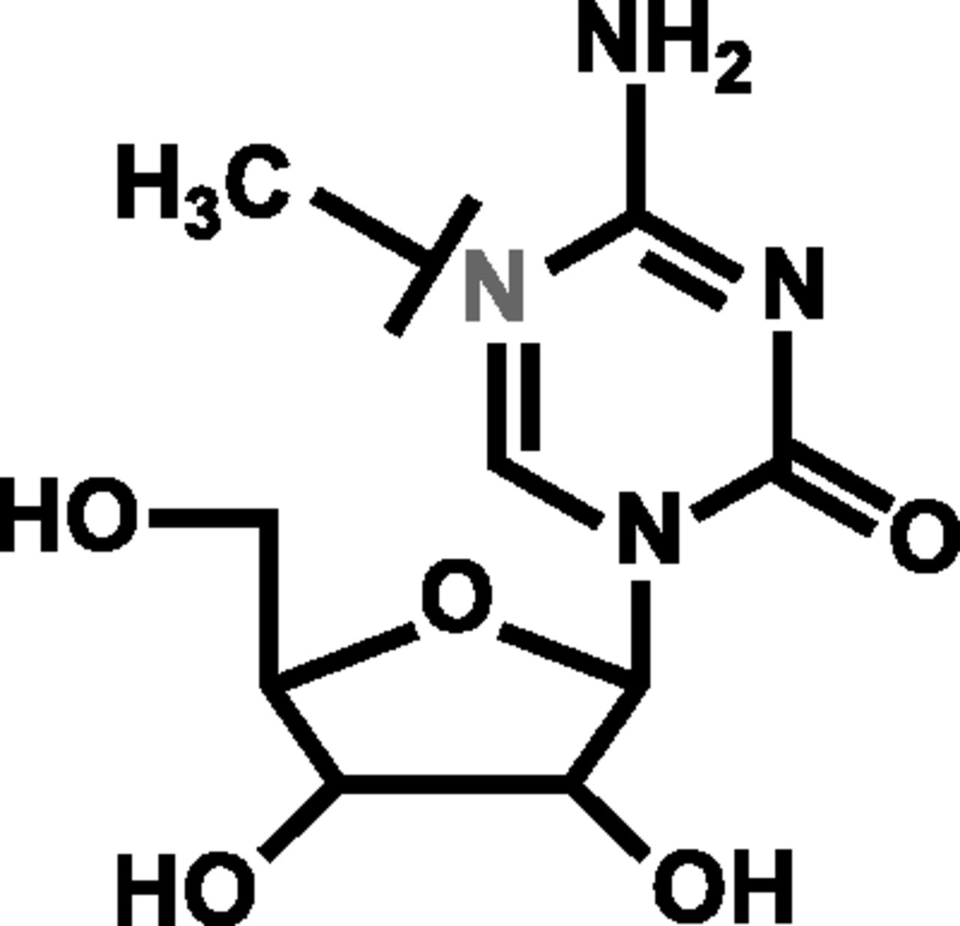
CC-486 Oral Azacitidine (Onureg®)
CC-486 is an oral hypomethylating agent
Oral dosing of CC-486 allows for extended drug exposure during each treatment, prolonging therapeutic activity
The hypothesis is that prolonged treatment with CC-486 could be effective as post-remission maintenance in AML
Azacitidine

Slide 32
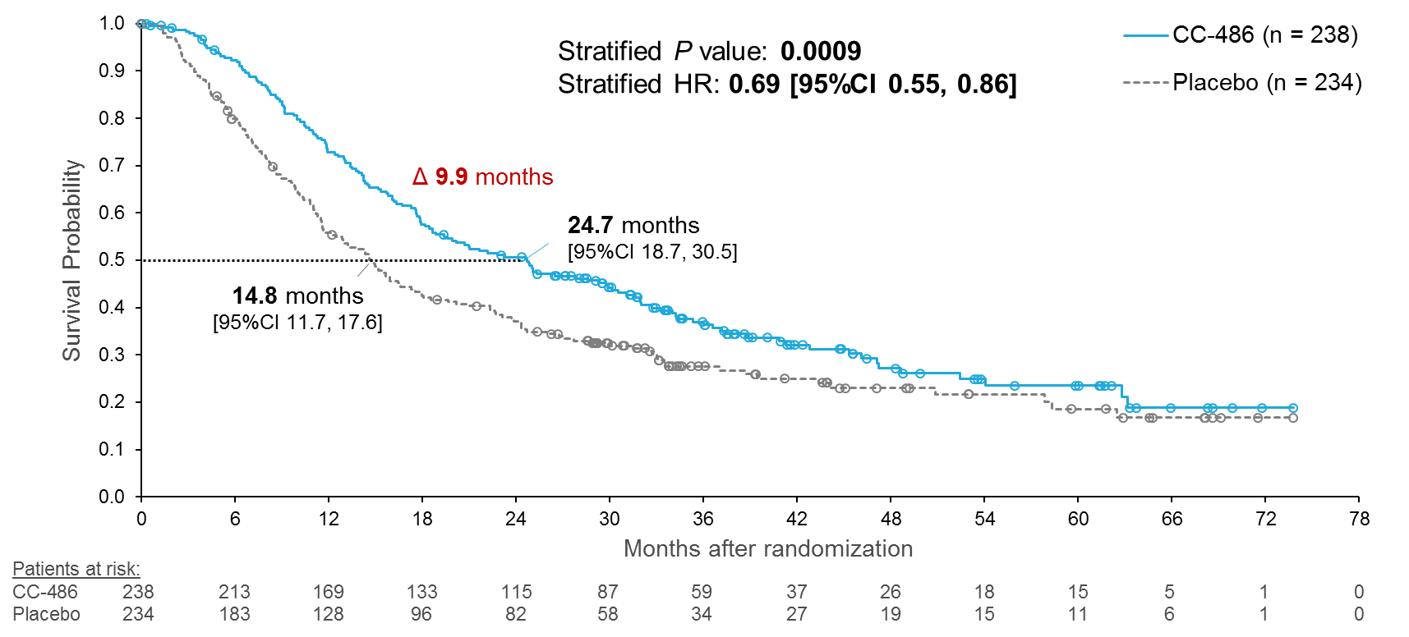
QUAZAR AML-001 International Randomized Maintenance Trial
CC-486
Placebo

Slide 33
Targeted Immunotherapy of AML (CAR-T in the future) Bispecific T-Engaging (BiTE), Dual Affinity Re-Targeting (DART)
Agent | Target, Construct | t ½ and Administration | Number | Cytokine Release Syndrome | Complete Remission/CRi
AMG-330¹ | CD33 BiTE | Short: Infusion 14-28d | 40 | 28% (higher?) | 4 pts @ Higher Doses
Flotetuzumab² | CD123 DART Small | Short: Infusion 28d | 31 (RP2D) | 30/31 (most mild) | 5 pts @ RP2D (esp. 1⁰ ref AML)
XMAB14045³ | CD123 BiTE Larger | Long t½: 1-3 x weekly | 66 | 55% | 5 pts @ Higher Doses
BiTE/DART: Myeloid-targeting immune/antibody constructs to induce autologous T-cell response Phase 1, all associated with cytokine release syndrome (CRS) and some CR’s. ¹Ravandi et al, abs. 25; ²Uy et al, abs. 764; ³Ravandi et al, abs. 763; ASH 2018

Slide 34
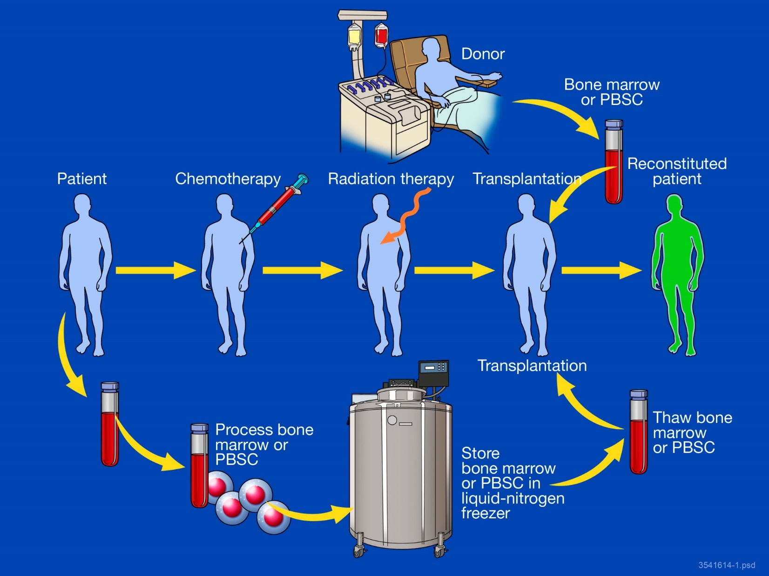
Blood or Bone Marrow Transplant

Slide 35
Sources of Stem Cells
Allogeneic - coming from another individual, related or unrelated
Matched related
Matched unrelated
Mismatched related (haploidentical or half matched)
Higher risk of graft-versus-host disease (GVHD)
Mismatched unrelated
Cord blood
Syngeneic - coming from an identical twin
Autologous - using the patient’s own blood or marrow stem cells

Slide 38
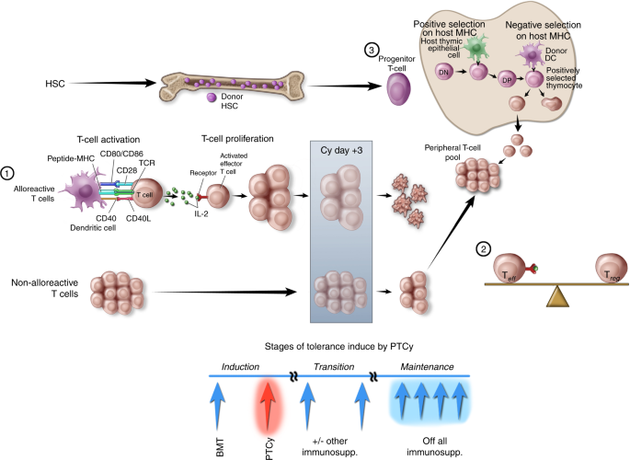
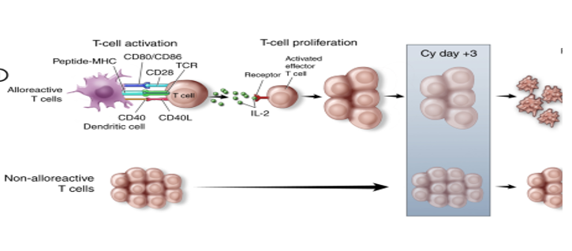
Post Transplant Cyclophosphamide for
Haploidentical Transplantation
T cells from
the donor

Slide 39
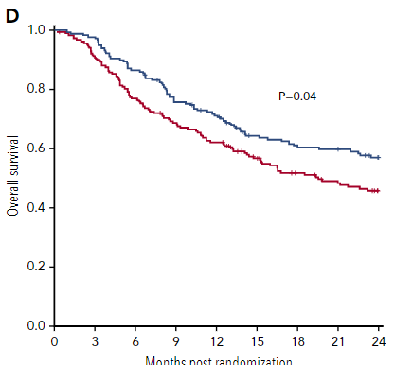
Double unrelated umbilical cord blood vs HLA-haploidentical bone marrow transplantation BMT CTN 1101 trial
368 pts, aged 18 to 70 years
lymphoma or acute leukemia in remission
randomly assigned to undergo unrelated umbilical (UCB) transplant (n=186)
or haploidentical transplant (n=182)
Haploidentical
Double UCB
Blood 137:420, January, 2021
Months after randomization

Slide 40
High Dose Conditioning Regimens (Chemoradiotherapy programs, 2-6 days)
Myeloablative regimens
Myelo = bone marrow and ablate = wipe out
High dose cyclophosphamide (Cytoxan®)
Cyclophosphamide plus total body irradiation (TBI)
Busulfan + Cyclophosphamide
Melphalan
BCNU, Ara-C, VP-16, Melphalan (BEAM)
Many others

Slide 41
Graft-versus-Leukemia Effect (GVL)
Donor T-cells can recognize host malignant cells (leukemia cells) as foreign
Can kill leukemia or cancer cells that may survive after the high dose chemotherapy or radiation

Slide 42
Horowitz, et al. Blood 75:555, 1990

Slide 43
Donor Lymphocyte Infusions
Peripheral blood lymphocytes are collected by apheresis from the patient’s original donor in a similar fashion to peripheral blood stem cells, but no stimulation with growth factor is given.
These lymphocytes are then given intravenously to the recipient without any prior treatment.
There is a risk of GVHD developing after the infusion.

Slide 44
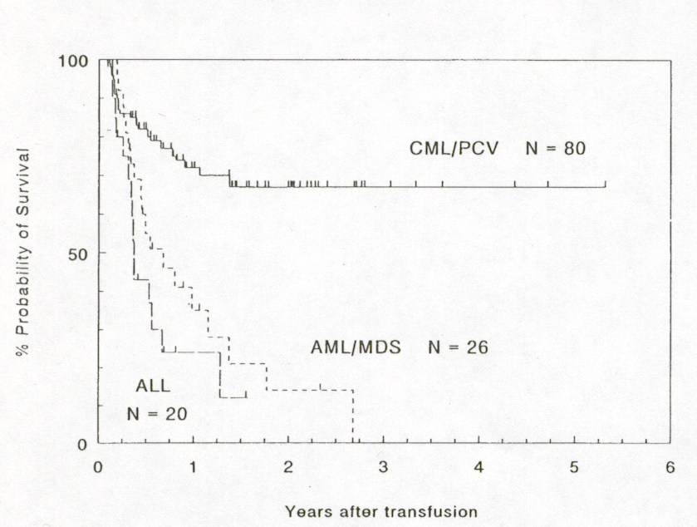
Survival in patients with recurrent leukemia after allogeneic BMT treated with donor lymphocyte infusions
Kolb HJ, et al. Blood 86:2041, 1995

Slide 45
Non-myeloablative BMT (NMT) (mini-transplant)
Reduced intensity conditioning (RIC)
Central dogma of BMT had been need to create space for incoming marrow
Animal studies have suggested this concept is flawed and that immune suppression is sufficient for engraftment
Success of donor lymphocyte infusions (DLI) and GVH/GVL effect for treatment of relapse post-allogeneic BMT confirms

Slide 46
Reduced Intensity

Slide 47
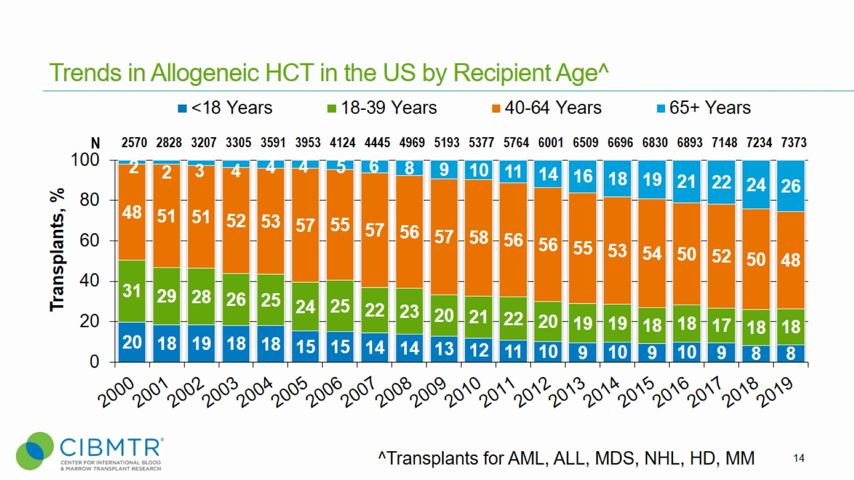
Trends in Allogeneic HCT in the US by Recipient Age^
Trends in Allogeneic HCT in US
by Recipient Age^{Ʌ}
Phelan, R., Arora, M., Chen, M. Current use and outcome of hematopoietic stem cell transplantation: CIBMTR US summary slides, 2020.
Notes:
Slide 14: The number of allogeneic transplants for treatment of malignant diseases in ≥65 years continues to increase. In 2019, 26% of allogeneic transplant recipients were age 65 and older.

Slide 48
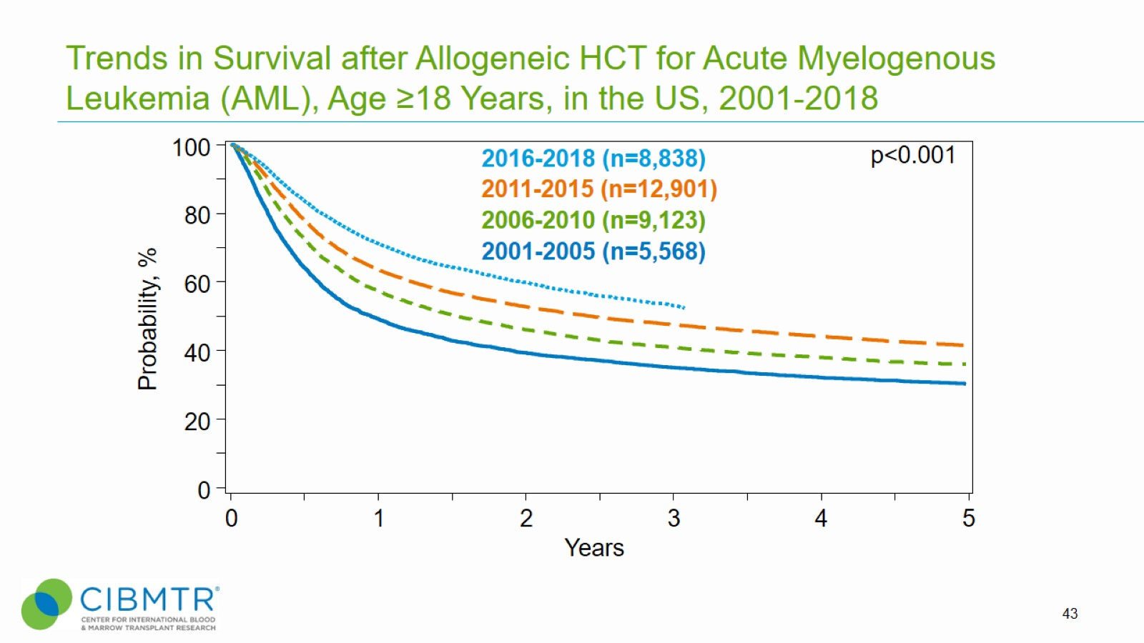
Trends in Survival after Allogeneic HCT for Acute Myelogenous Leukemia (AML), Age ≥18 Years, in the US, 2001-2018
Phelan, R., Arora, M., Chen, M. Current use and outcome of hematopoietic stem cell transplantation: CIBMTR US summary slides, 2020.
Notes:
Slide 43: This slide shows trends in survival after transplant in AML over time, showing survival gains in each subsequent time cohort for adults. 3-year survival for adults following alloHCT for AML was 35% ± 1%, 41% ± 1%, 48 ± 1%, and 53% ± 1% for the periods 2001-2005, 2006-2010, 2011-2015, and 2016-2018, respectively.

Slide 49
Conclusions
AML is a heterogeneous disease with multiple subtypes based on cell of origin and cytogenetic and molecular abnormalities
New drugs for treatment have been identified, some of which target specific gene abnormalities in the leukemic cells
Identification of low levels of leukemia (minimal residual disease) are helping guide treatment decisions
New advances in BMT are allowing us to identify a donor for almost everyone and offer BMT to older individuals

