Slide 1


Strive to Thrive: How to Protect Your Health after a Transplant Using Donor Cells (Allogeneic Transplant)
Celebrating a Second Chance at Life Survivorship Symposium
July 11-17, 2020
Areej El-Jawahri, MD
Massachusetts General Hospital

Slide 2

Strive to Thrive! How to Protect Your Health after an Allogeneic Transplant
Areej El-Jawahri MD
Director of the BMT Survivorship Program
Associate Director of Cancer Center Survivorship Program

Slide 3
Outline
Why survivorship care?
Who is able to provide survivorship care?
Common issues impacting transplant survivors
How to protect your health after transplant?
A little bit about living with chronic graft-versus-host disease (cGVHD)

Slide 4
Why Survivorship Care?
In 2010: 108,900 transplant survivors
In 2020: 250,000 transplant survivors
In 2030: anticipate >300,000 transplant survivors
Age distribution for transplant survivors
  Age 18 or less: 15%
  Age 18-59: 60%
  Age 60 or above: 25%

Slide 5
Why Survivorship Care?
The good news: we are doing better with transplant and patients are living longer. We have more survivors
As patients survive longer: we need to address potential health complications
40% of transplant survivors will develop severe health conditions 15 years after transplant
Life expectancy and quality of life of transplant survivors is less than the normal population

Slide 6
Why Survivorship Care?
Issues | Not a problem | Somewhat of a problem | A severe problem
Less physically able to have sexual intercourse | 52.7% | 30.1% | 17.2%
Feeling fearful that my illness will return | 31.7% | 53.8% | 14.5%
Fatigue, loss of strength | 34.5% | 52.7% | 12.8%
Concern about relapsing | 35.3% | 53.8% | 10.9%
Sleep difficulties | 47.2% | 46.9% | 10.1%
Fear about the future | 43% | 46.9% | 10.1%
Uncomfortable with change in my physical appearance | 59.9% | 32.7% | 7.5%
Being less able to provide for the financial needs of my family | 72.9% | 19.6% | 7.5%

Slide 7
Why Survivorship Care?
Issues | Not a problem | Somewhat of a problem | A severe problem
Not being able to change jobs for the fear of losing my health insurance | 81.7% | 11.1% | 7.2%
Continued major problems with my health | 61.7% | 31.2% | 7.1%
Having difficulties in making long-term plans | 62.5% | 31.0% | 6.5%
Difficulty in meeting my medical expenses | 74.7% | 18.8% | 6.5%
Difficulty obtaining adequate insurance | 81.3% | 12.6% | 6.1%
Feeling vulnerable | 62.2% | 32.6% | 5.2%
Difficulties with pursuing the career of my choice | 83.4% | 11.5% | 5.1%

Slide 8
Quality of Life in Transplant Survivors
Depression, anxiety, and emotional distress are common in transplant survivors
Pain is also an important symptom impacting transplant survivors
Chronic graft-versus-host disease (cGVHD) important risk factor for lower quality of life
Quality of life Emotional wellbeing

Slide 9
Components of Survivorship Care

Slide 10
Who is able to provide survivorship care?
Oncology Survivorship Clinics
Primary Care Clinicians
Family Practitioners
Nurses
Ask your transplant team for a Survivorship Care Plan:
  Details the treatment you received
  The long-term risks to watch for
  The tests you may need over time

Slide 11
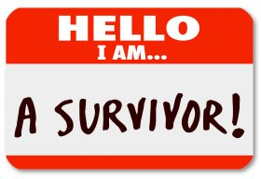
Common Issues Impacting
Transplant Survivors
Emotional Impact
Effects on Caregivers
Financial Impact
Long term medical concerns (i.e. Late Effects)
Chronic graft-versus-host disease (cGVHD) related concerns

Slide 12
Emotional Impact
Sadness and depression
Anxiety and Post-traumatic stress (PTSD)
Fear of recurrence
Anger
Guilt
Acceptance, growth, and gratitude

Slide 13

Effects on Caregivers
Caregivers provide majority of care for our transplant survivors
Caregivers have a stressful job
Chronic caregiving especially in the context of transplant
Immense caregiving burden
Impact on relationships
Impact on caregiver health

Slide 14
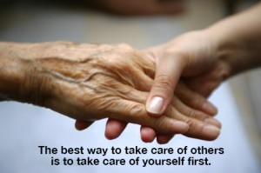
Effects on Caregivers
How to take care of yourself as a caregiver?
Set up a support system for yourself
Allow consistent time for yourself
Learn to ask for help
Prioritize and consider what you can let go of
Resources available to help caregivers

Slide 15

Financial Impact
Financial Strain
  Ask for financial assistance screen from your social worker
  Return to Work: Social workers are experts at helping patients navigate returning to work
    Reasonable accommodations
    FMLA
    American with Disabilities ACT (ADA)
    Equal Employment Opportunity Commission

Slide 16
Long Term Medical Concerns
Heart problems
Lung problems
Hormonal issues
Bone health
Sexual health
Fatigue
Second Cancers
Gastro-intestinal problems
Kidney/Bladder
Nerve pain
“Chemo-brain”
Skin issues
Oral health concerns
Eye health concerns

Slide 17
Take a Deep Breath….
The list of long-term medical concerns is long, but….
  These complications are relatively rare
  If we educate ourselves about them, we can take better care of ourselves and prevent them
  Don’t let the anxiety about these long term medical concerns impact your goals
  We are discussing long term medical concerns to EMPOWER you to advocate for yourself, to take the best possible care of your body, and to minimize your risk of medical problems!

Slide 18
What places survivors at risk?
Chemotherapy and radiation regimen intensity
  Total body irradiation (TBI)
  High-dose chemotherapy
Prior exposures to chemotherapy and radiation
Exposure to the use of corticosteroids over many months to years
Chronic suppression of the immune system over many months to years
Chronic graft-versus-host disease (cGVHD)

Slide 19
What other risks to consider?
    To truly understand the long-term risk, we must also understand the individual patient:
    Past medical history: other important health conditions
    Family history: cancers, early heart disease, or diabetes
    Lifestyle factors: Diet, physical activity, social supports, and coping
    Habits: Smoking, alcohol, exercise, drug use

Slide 20
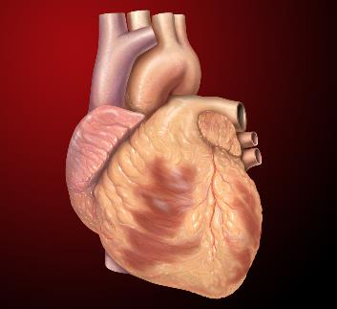
Heart Effects
Weakening of heart muscle
Heart disease (Coronary artery disease)
Risks: smoking, diabetes, sedentary lifestyle, high blood pressure and cholesterol, cGVHD
What can we do?
Make sure your cholesterol, sugars, blood pressure and weight are well managed
Talk to your doctor about whether you need a heart ultrasound or a stress test

Slide 21
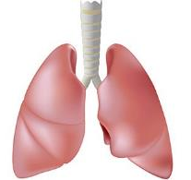
Lung Effects
Scarring in the lungs
Recurrent infections
Risks: radiation to the chest, certain chemotherapy drugs, smoking, personal history of lung disease, cGVHD
What can we do?
  No smoking or vaping
  Avoid getting respiratory viral infections
  Get pulmonary function tests and lung imaging on yearly basis depending on your risk

Slide 22
Hormonal issues
Early menopause
Low testosterone
Thyroid hormone problems
Infertility
Risks: High-dose chemotherapy and radiation, older age
What can we do?
Yearly screening for thyroid hormone problems
Discuss hormone replacement therapy with your doctor

Slide 23

Bone Health
Weak bones (Osteopenia and Osteoporosis)
Risks: Steroid use, high-dose chemo and radiation, early menopause, thyroid problems, low testosterone, smoking, and lack of exercise
What can we do?
Take calcium and vitamin D
Ask your doctor for bone density
Exercise and stop smoking

Slide 24

Sexual Health
60% of men and 80% of women experience sexual health problems after transplant
Most survivors do not discuss their sexual health concerns with their clinicians
Common issues:
  Women: Vaginal dryness and cGVHD
  Men: Erectile Dysfunction
  Men and Women: loss of libido, intimacy concerns
Many of these issues are addressable

Slide 25

Fatigue
Most common survivorship concern
Many causes of fatigue
What can we do?
  Recognize and treat underlying conditions
  Exercise programs 4-5 days per week, goal 30 minutes + interval training
  Nutrition and hydration
  Sleep
  Stress reduction: yoga, meditation, reiki
  Treat any anxiety or depression if present

Slide 26
Second Cancers
Transplant survivors are at slightly higher risk of having second cancers
Important to stay on top of cancer screening:
  Screening for skin cancers: see a skin doctor yearly
  Screening for breast and colon cancer
  Screening for lung cancer: if prior history of smoking
  Screening for prostate cancer: talk to your doctor
  If cGVHD of the mouth: screen for oral cancers yearly

Slide 27
Other Issues
Eye health: see your eye doctor regularly to look for cataracts and cGVHD affecting the eyes
Nerve pain: caused by chemotherapy: talk to your doctor about treatment options
“Chemo brain”: mostly gets better with time, but you can see a specialist to help if it persists one year after transplant

Slide 28
Stay engaged in your own health!
Engage your primary care clinician: They specialize in health maintenance and prevention
  Stay on top of your cancer screening and health issue
  Stay on top of your cholesterol, sugars, and blood pressure
Ask for a survivorship consultation if available

Slide 29
Stay engaged in your own health!
Healthy diet: rich in protein, vegetables and limit processed foods
Exercise regularly
Limit sun exposure: wear sunscreen 30++ SPF
Do NOT smoke or vape
Minimize alcohol intake
Watch your weight

Slide 30
A little bit about cGVHD
cGVHD affects 40-60% of allogeneic transplant survivors
Usually 3-18 months after transplant
Can affect any organ: mouth, skin, and eyes most common
Important to know if you have cGVHD: Sometimes clinicians can miss signs or symptoms that are due to cGVHD
Reach out to your transplant team if you are having new unexplained symptoms

Slide 31
A little bit about cGVHD
cGVHD has major effects on quality of life and symptom burden experienced by transplant survivors
Importance of self-care in managing symptoms of cGVHD
Coping with the uncertainty
Pay attention to your emotional health
Avoid infections

Slide 32
Reputable Resources
www.bmtinfonet.org
www.cancer.net
www.cancer.gov
www.asco.org
www.journeyforward.org
www.livestrong.org
www.LLS.org
www.nccn.org

Slide 33

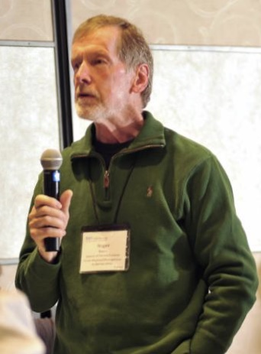
Questions?
Celebrating a Second Chance at Life Survivorship Symposium
July 11-17, 2020
bmtinfonet.org ✦ help@bmtinfonet.org ✦ 847-433-3313

