Slide 1
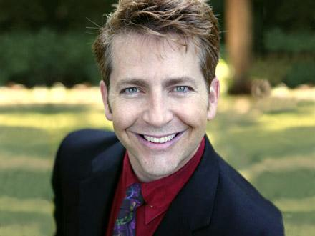
Sexual Health after Transplant: Men
Celebrating a Second Chance at Life
Survivorship Symposium
April 27 – May 3, 2024
Jeffrey Albaugh PhD, APRN, CUCNS
Urology Clinical Nurse Specialist, Jesse Brown VA Medical Center

Slide 2
Sexual Response Cycle
Excitement
Plateau
Orgasm
Resolution
Male = avg. 2.8 minutes
Female = avg. 13 minutes
Masters & Johnson, 1966

Slide 3
Genital Arousal
Starts with stimulation
Sexual thoughts integrated in brain and travel down spine to peripheral nerves and then penis
Nervous conduction between brain and genitals is essential
Leads to blood flow into the genitals (hardness)
Any disease or condition that impacts blood flow or nervous conduction could negatively affect genital arousal and sexual function

Slide 4
Male Sexual Dysfunction
Desire disorder
low libido
hypogonadism
Erectile dysfunction
inability to get and/or keep erections hard enough for sex
Orgasm disorders
Premature ejaculation
Difficulty reaching climax

Slide 5
Sexual Dysfunction after Transplant
62% of transplant patients and 79% of partners reported that sexual function had not been discussed with them –Gjaerde, L.K. et al. 2022.
Erectile dysfunction rates were 68.4% prior to transplant related to the other treatments aimed at achieving remission status and jumped to 100% 1 month after and down to 60% 1 year after - Anderson, L. J., et al, 2022.
Most often men reported erection and ejaculation issues - Wingard et al. , 1992; Syrjala et al. , 1998; Syrjala et al., 2008; Claessens et al., 2006
57% of men reported significant sexual issues - Gjærde, L. K., et al., 2023.
The large majority of men had abnormal hormone levels, mostly elevated LH and/or FSH and 38% had decreased T levels –Schimmer et al., 2001.

Slide 6
Basic Causes and Effects
Any treatment that may cause changes in the blood (such as decreased blood cells) could impact genital arousal and sexual function (mostly erections in men).
Chemotherapy and radiation can both impact sexual function and fertility
Radiation therapy can impact blood flow leading to erection issues and nerves leading also to orgasm issues
Some chemotherapy may impact hormones (testosterone) & damage nerves (alkylating agents)

Slide 7
Communication about Sex
Even though sex is everywhere in our culture, we don’t really talk about sex.
Plan when and where you will talk about it with a partner.
Lack of communication causes misperception of what partners want sexually.
Notes:
It is important to reduce tension when talking, and one way to do this is to eliminate pressure to perform. Which is to say, talk outside the bedroom. Knowing there is no likelihood of having to behave sexually relieves pressure, making it easier to talk.
Talk about obstacles to talking. Sometimes talking about the obstacles to talking makes it easier to later segue into the talk about sex itself.
Some of these obstacles to talking may be self-consciousness caused by physical changes. Sometimes a person not only has trouble accepting his own changes, but he has fear about how these changes are effecting his partner. For example, he might be concerned about changes in weight, scarring, catheters or ostomy appliances. Talking about these changes rather than denying their possible influence creates the possibility of a different kind of closeness.
Another obstacle to talking is not wanting to acknowledge personal fears of not being able to perform as well sexually as before. There is fear that the relationship will be hurt by a different level or kind of sexual functioning. Again, facing fears, sharing vulnerabilities is the best way of getting through them.
Another common obstacle to talking to each other is the fact that even before the cancer it was difficult to talk about sex, so now it is even more difficult than before. You need to remember that the more you talk about sex, the easier it gets, and you also need to remember that professional help is available if you get stuck.

Slide 8
Obstacles to Communication
Fear of not being able to perform well
Lack of comfort talking about sex historically, making it more difficult to start now
More you do it, easier it gets
Professional help available if you get stuck
Notes:
It is important to reduce tension when talking, and one way to do this is to eliminate pressure to perform. Which is to say, talk outside the bedroom. Knowing there is no likelihood of having to behave sexually relieves pressure, making it easier to talk.
Talk about obstacles to talking. Sometimes talking about the obstacles to talking makes it easier to later segue into the talk about sex itself.
Some of these obstacles to talking may be self-consciousness caused by physical changes. Sometimes a person not only has trouble accepting his own changes, but he has fear about how these changes are effecting his partner. For example, he might be concerned about changes in weight, scarring, catheters or ostomy appliances. Talking about these changes rather than denying their possible influence creates the possibility of a different kind of closeness.
Another obstacle to talking is not wanting to acknowledge personal fears of not being able to perform as well sexually as before. There is fear that the relationship will be hurt by a different level or kind of sexual functioning. Again, facing fears, sharing vulnerabilities is the best way of getting through them.
Another common obstacle to talking to each other is the fact that even before the cancer it was difficult to talk about sex, so now it is even more difficult than before. You need to remember that the more you talk about sex, the easier it gets, and you also need to remember that professional help is available if you get stuck.

Slide 9
Therapies
Counseling/Behavioral Therapy
Maximizing health with diet and exercise
Hormonal -Testosterone
Vacuum Devices
Pharmacological Agents
Surgery
Herbs- most don’t work and some are dangerous

Slide 10
Seeking Care
Urologists manage these problems using evidence-based care
Beware of herbal remedies which are not regulated by the FDA

Slide 11
Seeking Care cont’d
Beware of Men’s Clinics
Advertise well with huge promises of restoring “Manhood & Enhanced “Performance”
Quick and easy access
Sub‐standard evaluations
Poor care provided by non-urology trained personnel – mostly cosmetic/internal/family medicine
Rarely accept insurance/(cash‐only) model; Charge high fees
Utilize unproven treatments with limited effectiveness
Retail Men’s Clinics have 85K+ visits annually & Online 100‐250M annually
Dietrich, P. N., et al. 2023

Slide 12
Fertility
Treatments like chemotherapy, radiation, transplant and surgery can impact fertility
Sperm bank before treatment
Damage may occur to sperm with chemotherapy or radiation
is not recommended to impregnate a partner for a full year following treatment
some people wait two to five years after transplant for optimal sperm recovery

Slide 13
Desire
Definitions:
“The sum of forces that lean us toward & push us away from sexual behavior.” Levine, 2003 p. 280
“A subjective and motivating feeling state triggered by both internal and external cues, which may or may not result in overt sexual behavior.” Leiblum, S., 2010.
Components:
Drive - biological
Expectations/Wishes-cultural and reflect beliefs/Values
Motivation - psychological/relational

Slide 14
Hypogonadism
Low testosterone blood level
Consistent symptoms:
low sex drive
decreased spontaneous erections
decreased energy and/or mood
poor concentration or memory
reduced muscle bulk/strength
increased body fat
decreased physical performance
Notes:
T declines with age about 1% a year from age 30 in both men & women. Don’t test if acutely ill, hospitalized, severely obese with fatique

Slide 15
Hypogonadism cont’d
Testosterone replacement has every bit as many negatives as positives and in some cases more.
endo-society.org/guidelines/Current-Clinical-Practice-Guidelines.cfm
Notes:
T declines with age about 1% a year from age 30 in both men & women. Don’t test if acutely ill, hospitalized, severely obese with fatique

Slide 16
Testosterone Not Recommended
Breast or prostate cancer
Abnormal Digital Rectal Exam (DRE) or PSA >4 or if risks >3 for Prostate Cancer
High hemoglobin blood counts
Untreated severe sleep apnea
Severe prostate issues
Uncontrolled heart failure
If trying to father a child

Slide 17
Hypogonadism Replacement Treatment in Men
Injections
Topical non-genital patches
Topical gels/solutions
Patch that goes on the gums
Testosterone pellets
Testosterone pills

Slide 18
Reclaiming Desire: Non-Hormonal Approaches
Critical: Anticipation/mystery and worthiness
-feeling you deserve sexual satisfaction
Remove all guilt, blame and pressure
Essence of sexuality is giving and receiving pleasure-oriented touch and connecting with each other
Requires intimacy, pleasure, mystery and eroticism
Developing yours, mine and ours bridges to desire
McCarthy, B. & McCarthy, E. 2003. Rekindling Desire. Taylor and Routledage, Hove East Sussex

Slide 19
A Different Way of Thinking about Intimacy and Sex
It is about pleasure
There are many, many ways to experience sexual pleasure
don’t limit you or your partner to only penetrative sex
The excitement comes from the anticipation and from the mystery of where intimacy will lead us today
Intimacy – connectedness to the other person!

Slide 20
Erectile Dysfunction Treatment: Vacuum Constriction Device (VCD)
FDA approved for over-the-counter distribution - efficacy rates of 80%-90% reported
Pros: Non-invasive and it works if you are trained properly and practice with it to mastery, fairly inexpensive
Cons: Cumbersome, not as natural erection, must wear a ring during sex

Slide 21
Erectile Dysfunction Treatment: Pills
Sildenafil (Viagra®) 25-100mg
Vardenafil (Levitra®) 5-20 mg; Staxyn® 10 mg disintegrating tablet
Tadalafil (Cialis®) 5-20 mg on demand and 2.5-5mg Daily
Avanafil (Stendra®) 50-200mg
Pros: Easy & Discreet
Cons: May have side effects, don’t always work for everyone

Slide 22
Treatment: MUSE®
Urethral suppository
Inserted right after urinating
Pros: Easy
Cons: Doesn’t work in most men and can have side effects, expensive

Slide 23
Erectile Dysfunction Treatment: Injections
Penile injections given at base of penis on side
Pros: They work in about 70-80% of men; they produce a fairly natural erection and no ring to hold it
Cons: You have to inject your self in the penis; there can be side effects, they are expensive

Slide 24
Surgery
Penile implant of inflatable cylinders that go in the penis with a pump in the scrotum
Pros: It works for most men and it goes everywhere you go
Cons: It is permanent, it is surgery, it can have side effects, is expensive

Slide 25
Ejaculation/Orgasm Problems
Premature: Inability to control climax with distress; often within a minute
Distraction, positioning, stop/start, squeeze technique, recent climax
Layered condoms
Promescent® Fast Acting Spray
Numbing creams or Condoms
Medication - antidepressants (OFF LABEL USE)
Delayed climax: vibratory stimulation

Slide 26
Key Points
Sexual dysfunction is common in men after transplant.
Sexual and intimacy issues can be addressed successfully.
Communication can be critical in dealing with changes in sex and intimacy.
It is possible to have enjoyable sex and intimacy after cancer treatment with the help of expert providers.

Slide 27
Resources for Patients
northshore.org/urological-health/patient-education/sexual-health-videos
sexhealthmatters.org/

Slide 28
Questions?
Jeffrey Albaugh PhD, APRN, CUCNS
Urology Clinical Nurse Specialist, Jesse Brown VA Medical Center

Slide 29
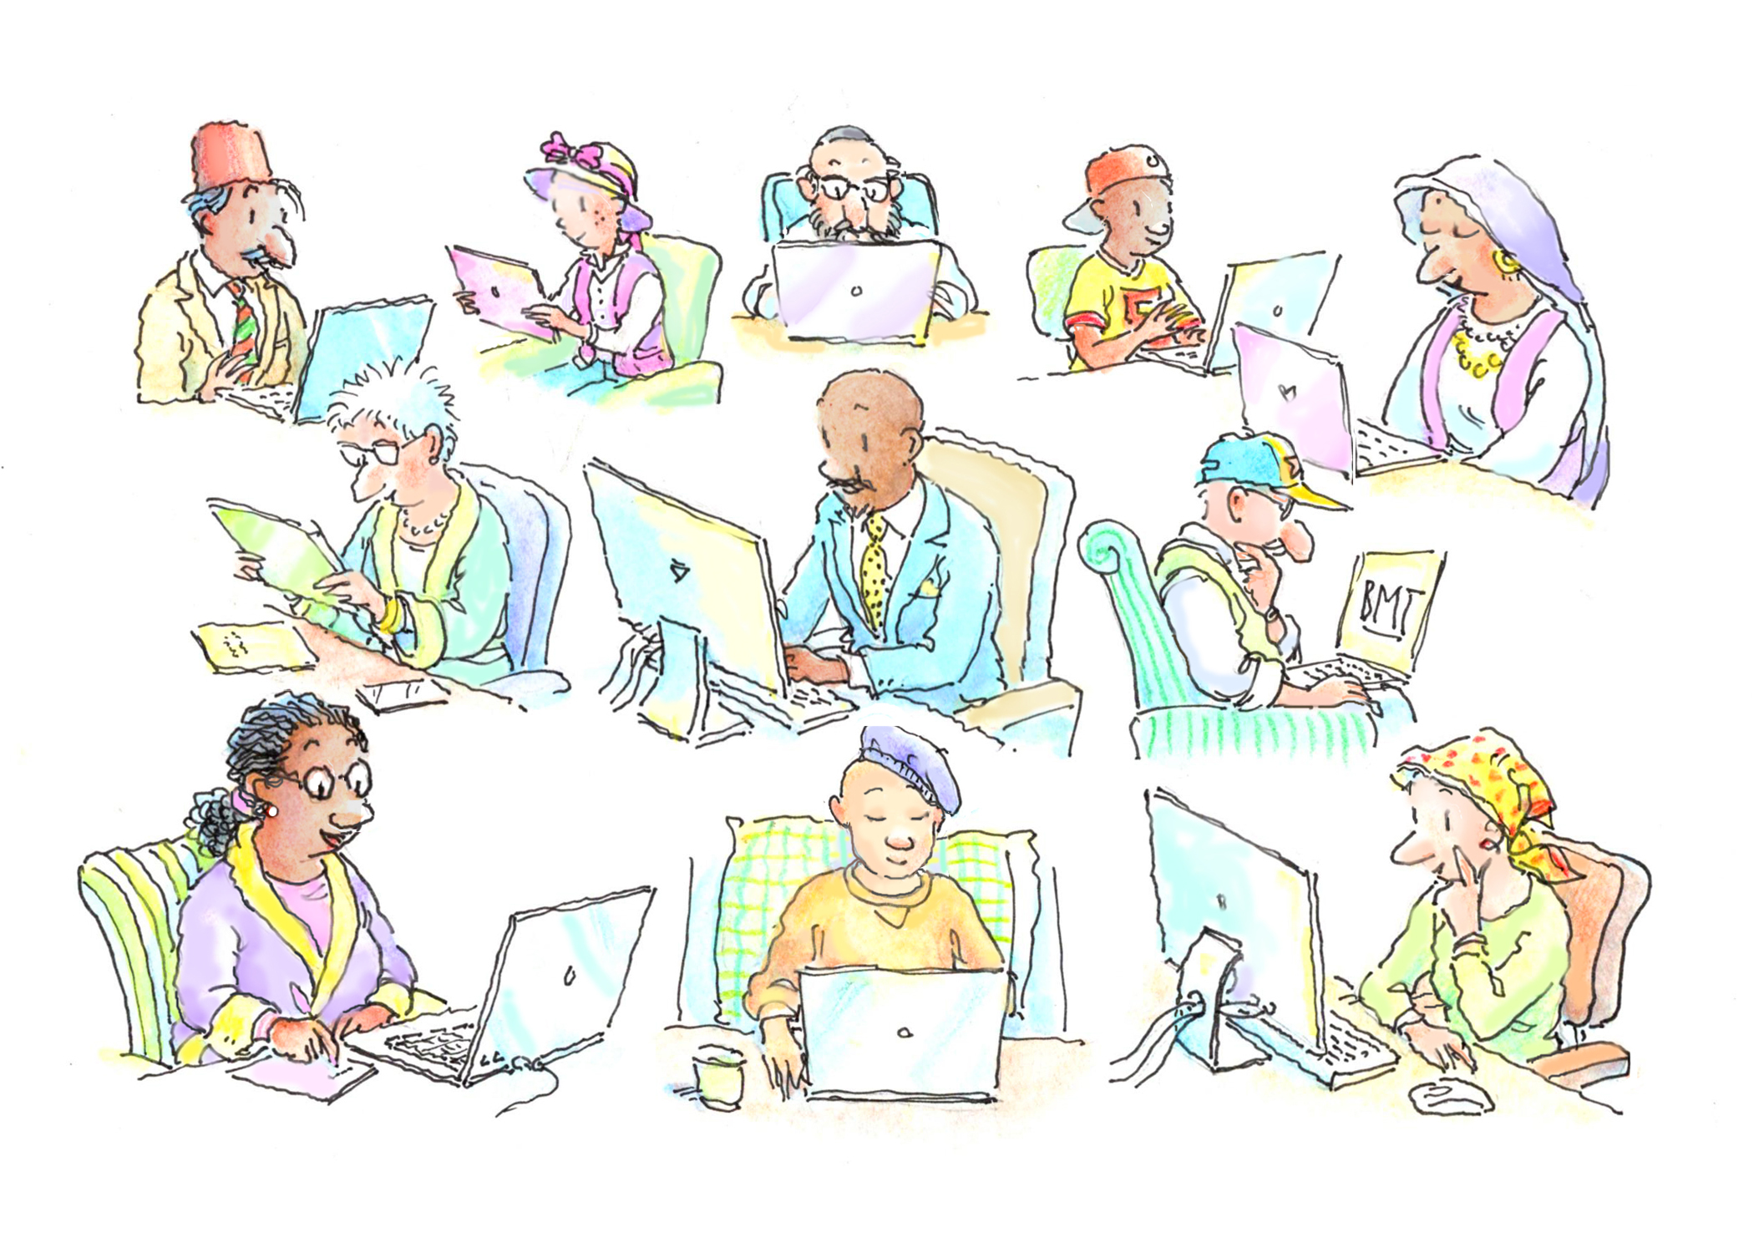
Let Us Know How We Can Help You
Visit our website: bmtinfonet.org
Email us: help@bmtinfonet.org
Phone: 888-597-7674 or 847-433-3313
Find us on:
Facebook, facebook.com/bmtinfonet
X, twitter.com/BMTInfoNet

